Slide 1
Home Decor
College Name: Birla Vishwakarma Mahavidyalaya Engineering College
Department Name: Computer Gia
Subject: Web Technology
BY
PATEL KRUPA (20CP301)
VASAVA PRACHI (20CP302)

Slide 2
Home Decor
This is new concept were a website gathering all type of interior designers in a digital way.
The main benefits of this website is we are meeting all kind of interior designer at one place and giving best option to choose from them.
All trusted designers will be managed by admin.
The 3 modules are:
Admin
Designers
Users

Slide 3
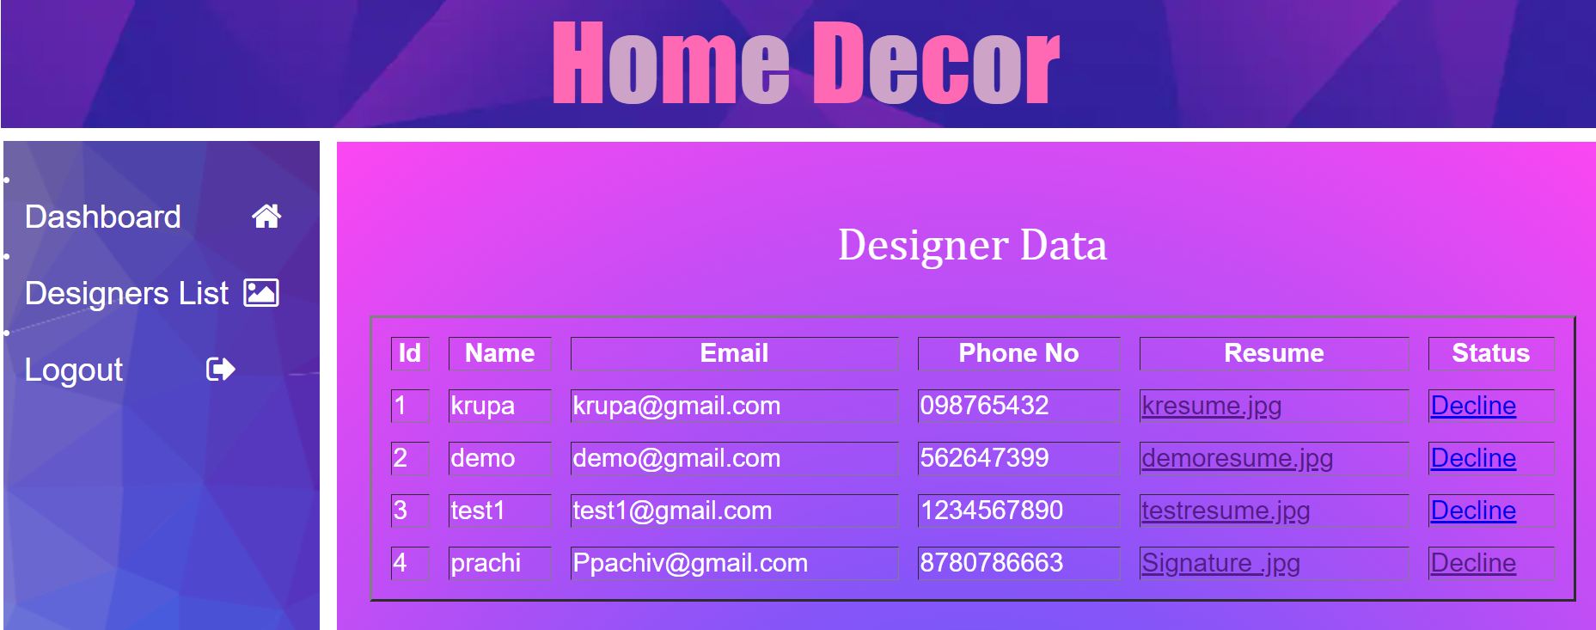
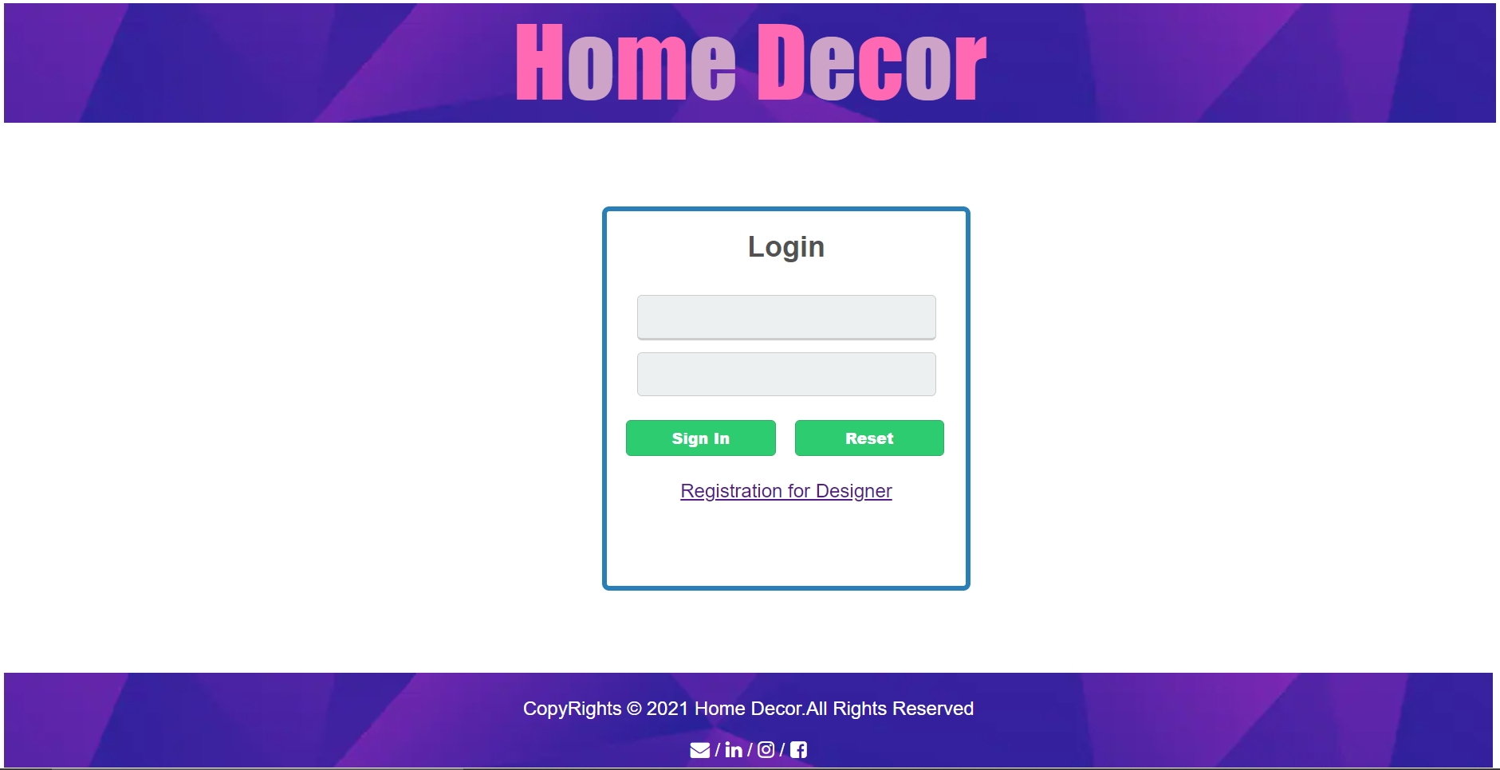
Functions
Admin
Login
Edit, Add and view designers

Slide 4
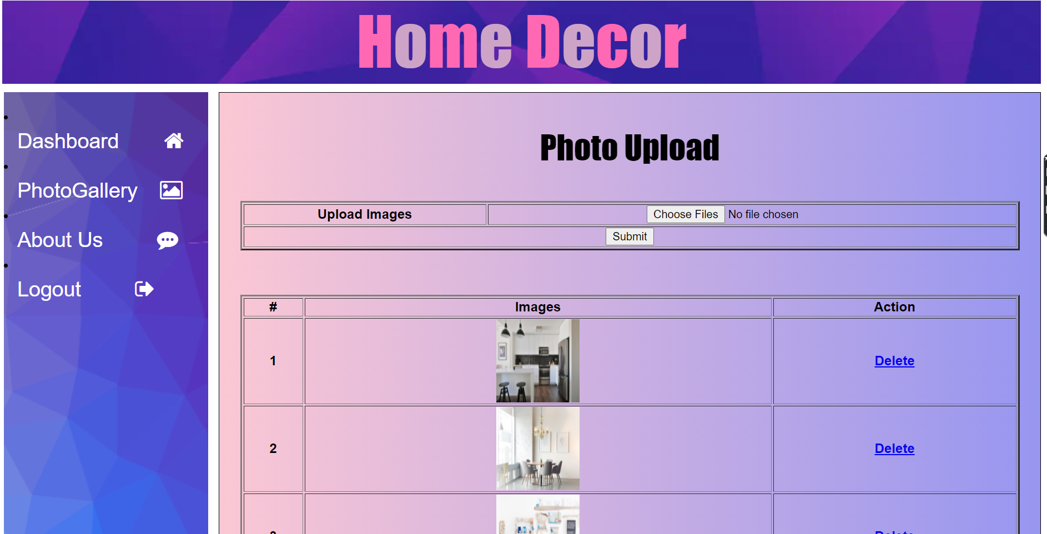
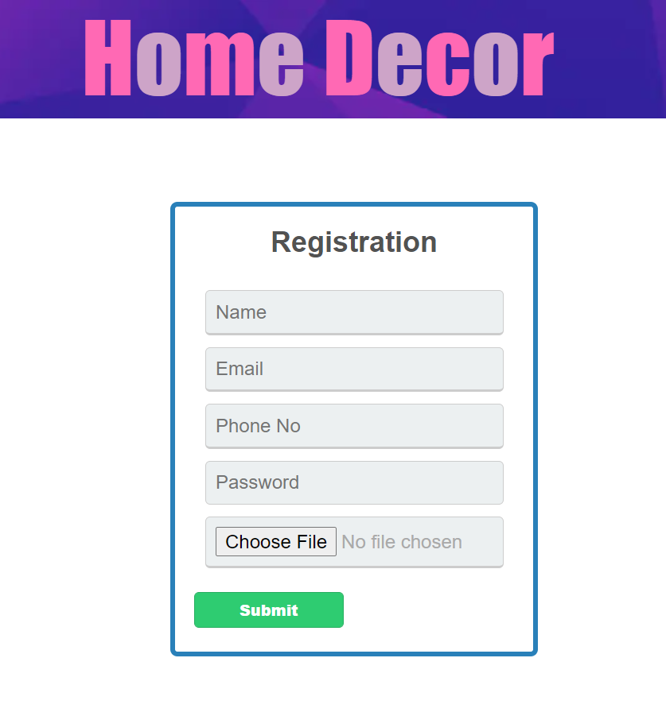
Functions
Designers
Login and Register themselves
Upload projects Pictures

Slide 5
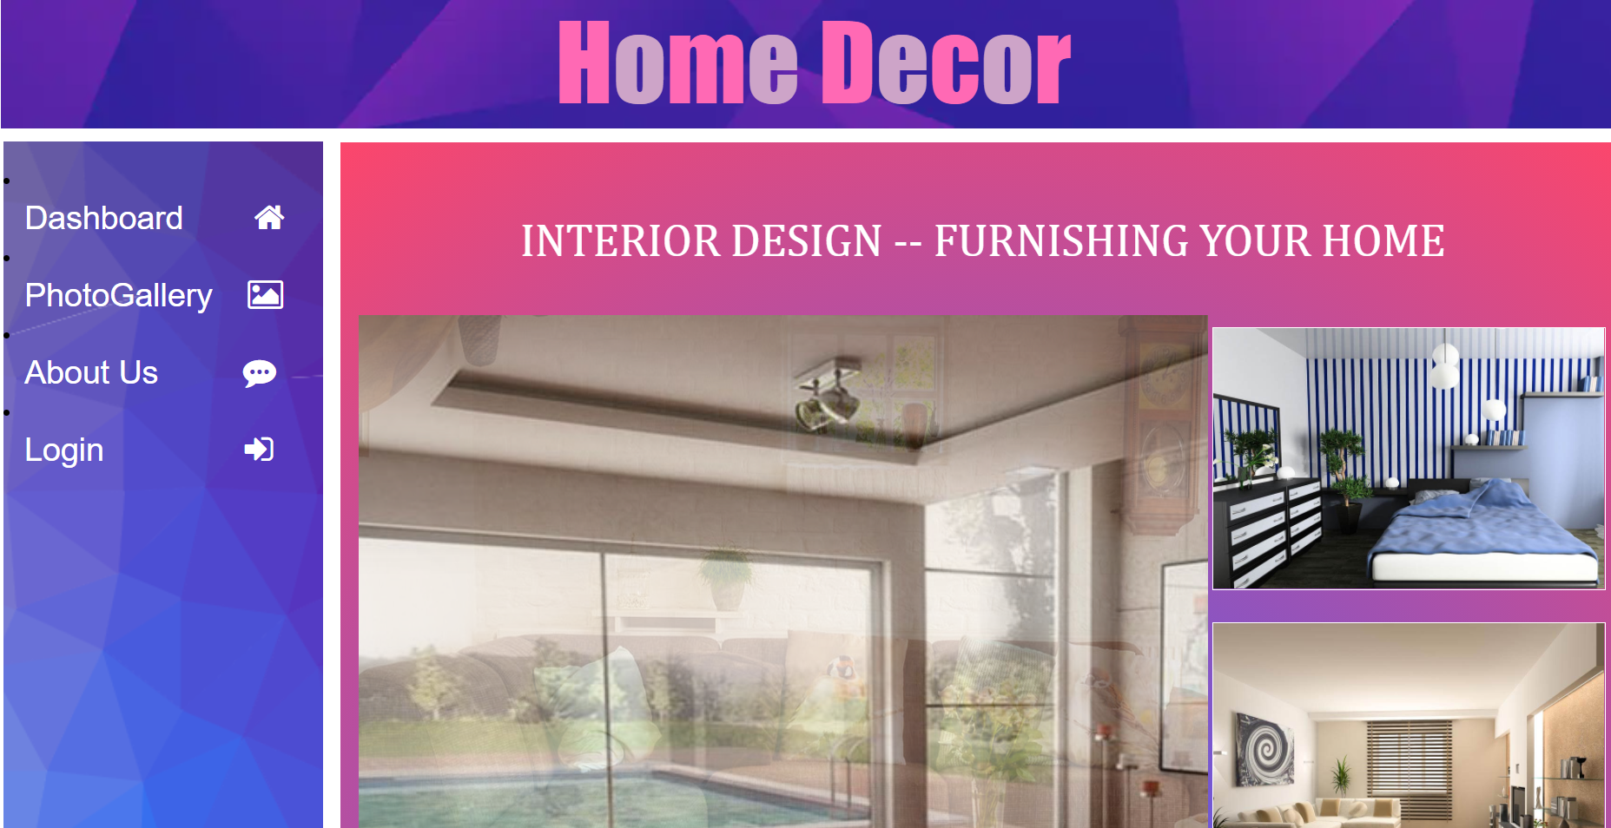
Functions
Users
Can see pictures and contact designers.

Slide 6
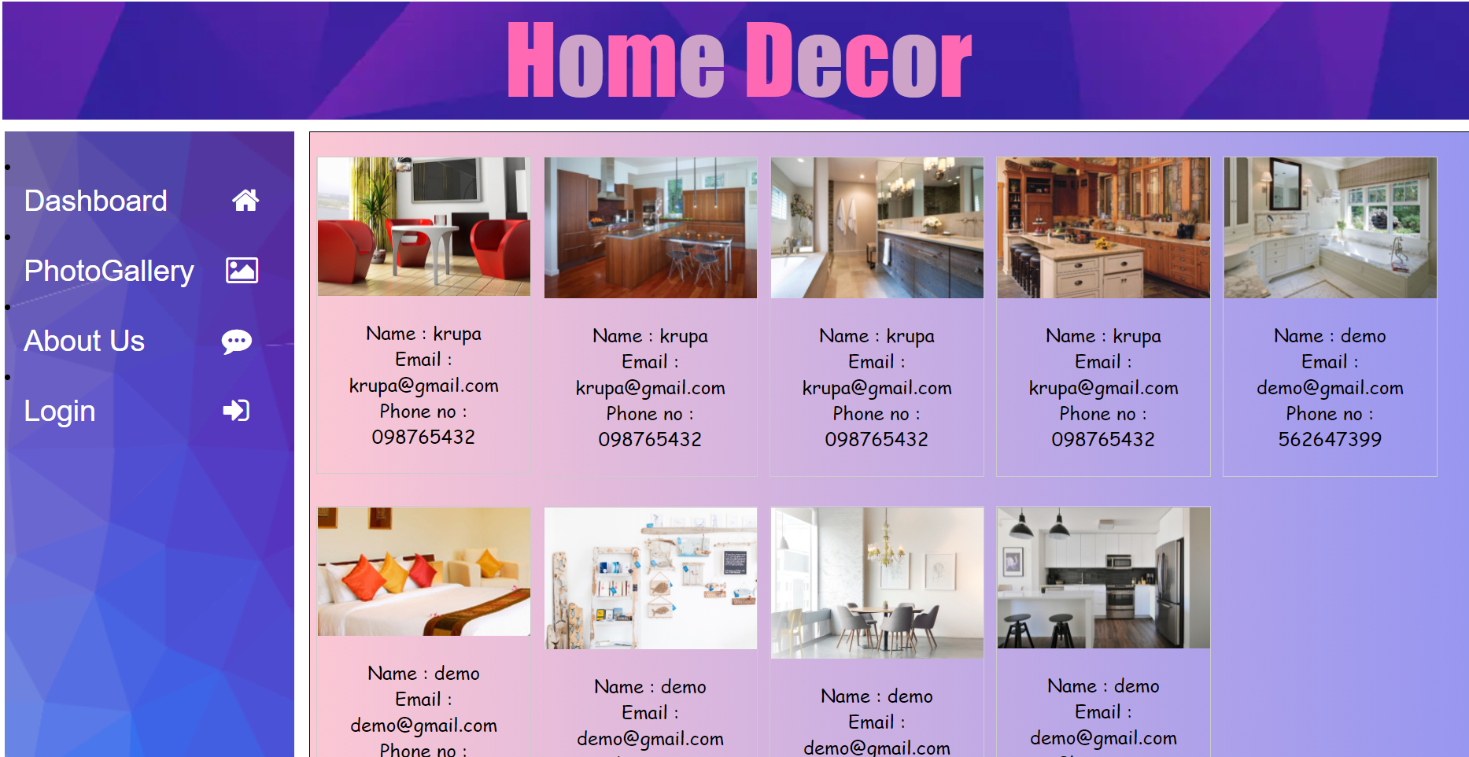
Photo Gallery

Slide 7
Benefits
Interior Designers
By digital marketing allows reaching maximum customers just at a single click
Best place to show their talent.
User
Save time , money and is really headache to visit the place and compare all.
So here user gets best option to pick among all designers.

